Slide 1
Guide to Programming with Python
Chapter One
Getting Started: The Game Over Program

Slide 2
Objectives
Introduce Python
Demonstrate how to install Python
Explain how to print text to the screen
Describe comments and how to use them
Demonstrate Python’s development environment, IDLE, using it to write, edit, run, and save programs
Guide to Programming with Python

Slide 3
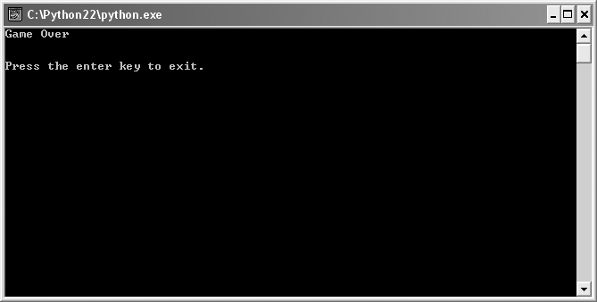
Examining the Game Over Program
Figure 1.1: Game Over Program Output
The all-too familiar words from a computer game
Guide to Programming with Python

Slide 4
Examining the Game Over Program (continued)
“Hello World” program: By tradition, prints "Hello, world!”
  Often used as first program
Console window: Provides a text-based interface to operating system
Guide to Programming with Python

Slide 5
Introducing Python
Powerful yet easy to use programming language
Developed by Guido van Rossum
First released in 1991
Named after comedy troupe Monty Python
An alarming number of references to spam, eggs, and the number 42 in documentation
Guide to Programming with Python

Slide 6
Python Is Easy to Use
High-level language: Separate from the low-level processor operations; closer to human language than machine language
"Programming at the speed of thought"
Increases productivity
  Python programs three to five times shorter than Java
  Python programs five to ten times shorter than C++
Guide to Programming with Python

Slide 7
Python Is Easy to Use (continued)
Python Program
  print "Game Over!"
C++ Program
  #include <iostream>
  int main()
  {
  std::cout << "Game Over!" << std::endl;
  return 0;
  }
Guide to Programming with Python

Slide 8
Python Is Powerful
Used by large organizations
  NASA
  Google
  Microsoft
Used in published games
  Battlefield 2
  Civilization IV
  Disney’s Toontown Online
Guide to Programming with Python

Slide 9
Python Is Object-Oriented
Object-oriented programming (OOP): Methodology that defines problems in terms of objects that send messages to each other
  In a game, a Missile object could send a Ship object a message to Explode
OOP not required, unlike Java and C#
Guide to Programming with Python

Slide 10
Python Is a “Glue” Language
Can be integrated with other languages
  C/C++
  Java
Use existing code
Leverage strengths of other languages
  Extra speed that C or C++ might offer
Guide to Programming with Python

Slide 11
Python Runs Everywhere
Platform independent: Independent of the specific computer operating system
Python runs on
  Windows
  DOS
  Mac OS
  Linux
  Many more
Guide to Programming with Python

Slide 12
Python Has a Strong Community
As an approachable language, has approachable community
Python Tutor mailing list
  http://mail.python.org/mailman/listinfo/tutor
  Perfect for beginners
  No actual "tutors" or "students"
Guide to Programming with Python

Slide 13
Python Is Free and Open Source
Open source: Publicly available; open source software typically programmed by volunteers; anyone can use source code without fee
Can modify or even resell Python
Embracing open-source ideals is part of what makes Python successful
Guide to Programming with Python

Slide 14
Setting up Python on Windows
Using the CD-ROM that came with the book
  Find the Python Windows Installer, Python-2.3.5.exe, under the Software section
  Click on the Install Python 2.3.5 from this CD-ROM link and run the installer
  Accept the default configuration
  Version 2.3.5 installed in the C:\Python23 folder
Guide to Programming with Python

Slide 15
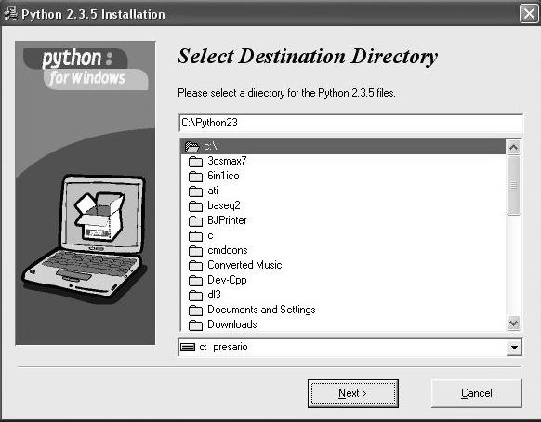
Setting up Python on Windows (continued)
Figure 1.2: Python Installation Dialogue under Windows
Your computer is soon to be home to Python.
Guide to Programming with Python

Slide 16
Setting up Python on Other Operating Systems
Download appropriate version from Python home page at www.python.org
Linux
  Python may already be installed
  Test: try running python at command prompt
  If not installed, go to Python home page to download
Mac OS
  After Python page, visit MacPython page at http://homepages.cwi.nl/~jack/macpython/index.html
Guide to Programming with Python

Slide 17
Introducing IDLE
Integrated Development Environment (IDE): Application that helps software developers write programs
  Like a word processor for your code
IDE that ships with Python
Has two “modes”: Interactive and Script
Guide to Programming with Python

Slide 18
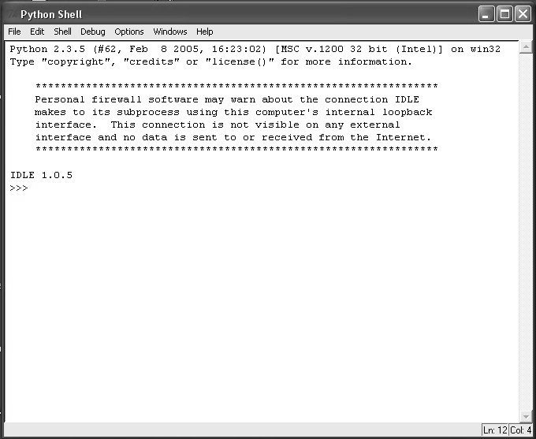
Programming in Interactive Mode
Figure 1.4: Python in interactive mode
Python awaits your command.
Guide to Programming with Python

Slide 19
Programming in Interactive Mode (continued)
Great for immediate feedback
  Test a simple idea
  Remember how something works
Open Python in interactive mode
  In Windows, from the Start menu, choose Programs, Python 2.3, IDLE (Python GUI)
Guide to Programming with Python

Slide 20
Programming in Interactive Mode (continued)
At command prompt (>>>), type: print "Game Over"
Python responds with: Game Over
Guide to Programming with Python

Slide 21
Programming in Interactive Mode (continued)
print Statement can display a string
String: Sequence of characters
Statement: Single unit in programming language that performs some action
  print "Game Over"
Expression: Something which has a value or that can be evaluated to a single value
  "Game Over"
  7 + 2
Code: Sequence of programming statements
Guide to Programming with Python

Slide 22
Programming in Interactive Mode (continued)
Syntax highlighting: Displaying programming code in different colors or fonts, according to the category of each item
Errors
  Computers take everything literally
  primt "Game Over" produces an Error Message: SyntaxError: invalid syntax
  Syntax error: Error in the rules of usage; often a typo
  Bug: Error in programming code
Guide to Programming with Python

Slide 23
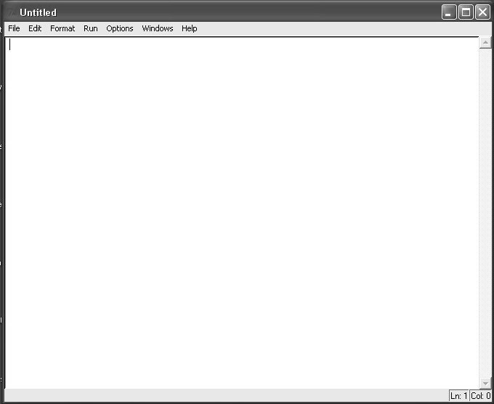
Programming in Script Mode
Figure 1.5: Python in script mode
Your blank canvas awaits.
Guide to Programming with Python

Slide 24
Programming in Script Mode (continued)
Great for programs you want to run later
  Write, edit, save, and load programs
  Like word processor for your programs
    Find and replace
    Cut and paste
Open a script window
  In interactive window, select File menu, New Window
Guide to Programming with Python

Slide 25
Programming in Script Mode (Continued)
Write program
  In script window, type print "Game Over"
Save program
  Select File, Save As, name game_over.py
  Always save before running
Run Program
  Select Run, Run Module
  Results displayed in interactive window
Guide to Programming with Python

Slide 26
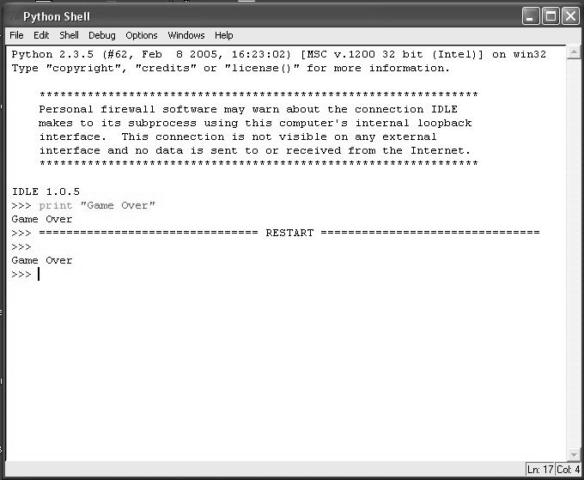
Programming in Script Mode (continued)
Figure 1.6: Python after a script has been run
The results of running the Game Over program
Guide to Programming with Python

Slide 27
The Game Over Program
# Game Over
# Demonstrates the print command
print "Game Over"
raw_input("\n\nPress the enter key to exit.")
Guide to Programming with Python

Slide 28
The Game Over Program (continued)
Comment: Note in source code meant only for programmers; ignored by computer
  Start comment with #
  Use opening block of comments
Blank Lines
  Also (generally) ignored by computer
  Use for readability; keep related code together
Console Window
  Final line keeps console window open
Guide to Programming with Python

Slide 29
Summary
Python is a high-level, object-oriented programming language that’s powerful yet easy to use
Python can interface with other programming languages
IDLE is Python’s standard IDE
IDLE has an interactive mode that offers immediate response to Python code
IDLE has a script mode that allows programmers to write, edit, load, save, and run their programs
Guide to Programming with Python

Slide 30
Summary (continued)
A string is a sequence of characters
A statement is a single unit of programming that performs some action
The print statement displays strings on the screen
An expression is something which has a value or that can be evaluated to a single value
Syntax highlighting is displaying programming code in different colors or fonts, according to the category of each item
Guide to Programming with Python

Slide 31
Summary (continued)
A syntax error is a violation of the grammar of a programming language; often caused by a typo
A bug is an error in programming code
A comment is a note in source code meant only for programmers; ignored by computer
Comments start with #
You should use an opening block of comments in your programs to identify the programmer, the creation date, and the program’s purpose
Guide to Programming with Python

